Slide 1
Chapter 6: Synchronization Tools

Slide 2
Outline
Background
The Critical-Section Problem
Peterson’s Solution
Hardware Support for Synchronization
Mutex Locks
Semaphores
Monitors
Liveness
Evaluation

Slide 3
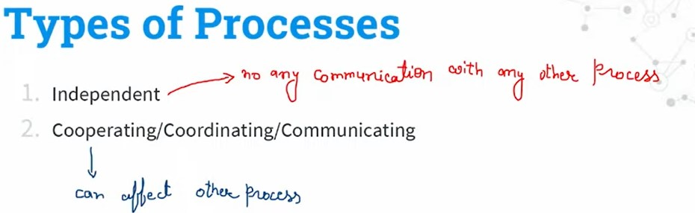

Slide 4



Slide 5
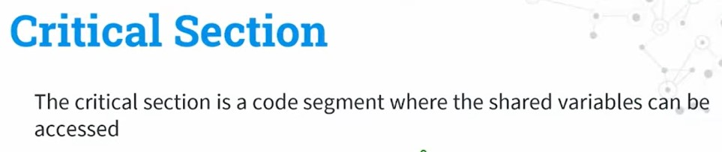
Critical Section

Slide 6

Critical Section

Slide 7
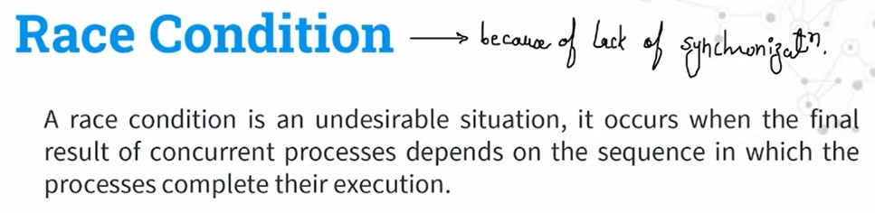
Race Condition

Slide 8
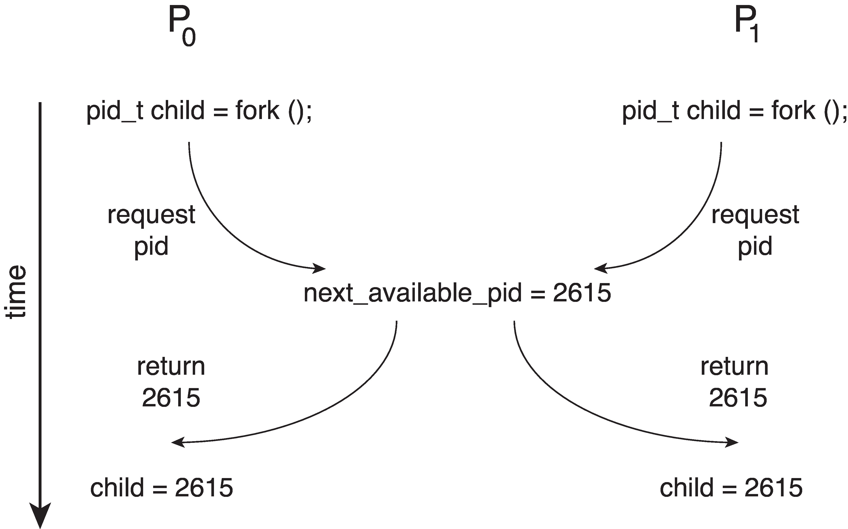
Race Condition
Processes P₀ and P₁ are creating child processes using the fork() system call
Race condition on kernel variable next_available_pid which represents the next available process identifier (pid)
Unless there is a mechanism to prevent P₀ and P₁ from accessing the variable next_available_pid the same pid could be assigned to two different processes!

Slide 9
Critical Section Problem
Consider system of n processes {p₀, p₁, … p_{n-1}}
Each process has critical section segment of code
Process may be changing common variables, updating table, writing file, etc.
When one process in critical section, no other may be in its critical section
Critical section problem is to design protocol to solve this
Each process must ask permission to enter critical section in entry section, may follow critical section with exit section, then remainder section

Slide 10
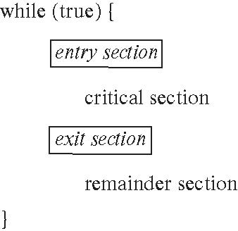
Critical Section
General structure of process P_{i}

Slide 11
Critical-Section Problem (Cont.)
Requirements for solution to critical-section problem
Mutual Exclusion - If process P_{i} is executing in its critical section, then no other processes can be executing in their critical sections
Progress - If no process is executing in its critical section and there exist some processes that wish to enter their critical section, then the selection of the process that will enter the critical section next cannot be postponed indefinitely
Bounded Waiting - A bound must exist on the number of times that other processes are allowed to enter their critical sections after a process has made a request to enter its critical section and before that request is granted
Assume that each process executes at a nonzero speed
No assumption concerning relative speed of the n processes

Slide 12
Software Solution 1
Two process solution
Assume that the load and store machine-language instructions are atomic; that is, cannot be interrupted
The two processes share one variable:
int turn;
The variable turn indicates whose turn it is to enter the critical section
initially, the value of turn is set to i

Slide 13
Algorithm for Process P_{i}
while (true){
while (turn = = j);
/* critical section */
turn = j;
/* remainder section */
}

Slide 14
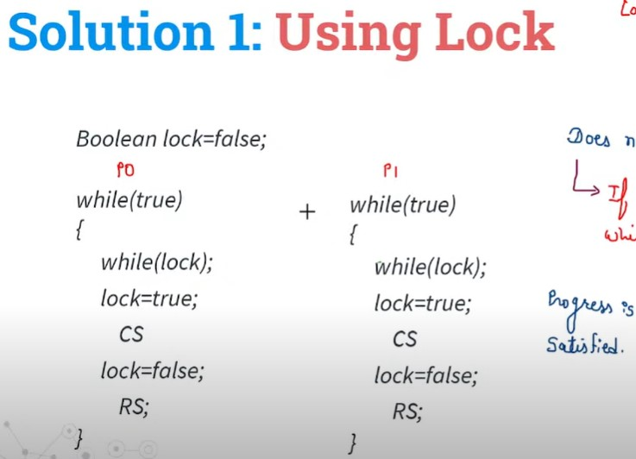
Using Lock Variable

Slide 15

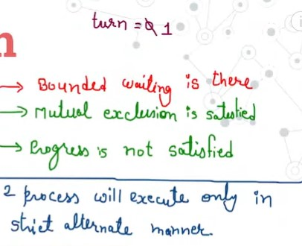
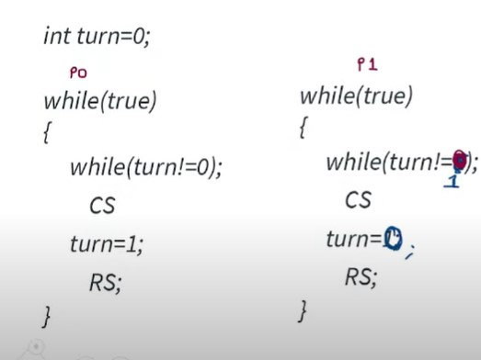

Slide 16
Peterson’s Solution
Two process solution
Assume that the load and store machine-language instructions are atomic; that is, cannot be interrupted
The two processes share two variables:
int turn;
boolean flag[2]
The variable turn indicates whose turn it is to enter the critical section
The flag array is used to indicate if a process is ready to enter the critical section.
flag[i] = true implies that process P_{i} is ready!

Slide 17
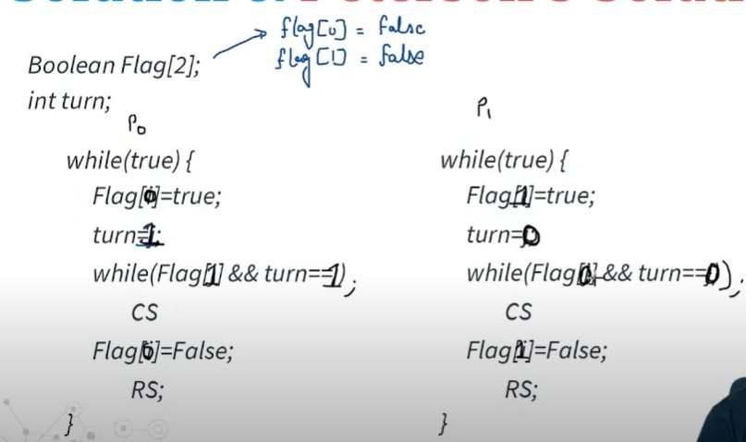
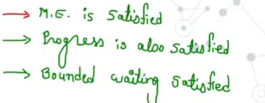

Slide 18
Algorithm for Process P_{i}
while (true){
flag[i] = true;
turn = j;
while (flag[j] && turn = = j)
;
/* critical section */
flag[i] = false;
/* remainder section */
}

Slide 19
Peterson’s Solution and Modern Architecture
Although useful for demonstrating an algorithm, Peterson’s Solution is not guaranteed to work on modern architectures.
To improve performance, processors and/or compilers may reorder operations that have no dependencies
Understanding why it will not work is useful for better understanding race conditions.
For single-threaded this is ok as the result will always be the same.
For multithreaded the reordering may produce inconsistent or unexpected results!

Slide 20
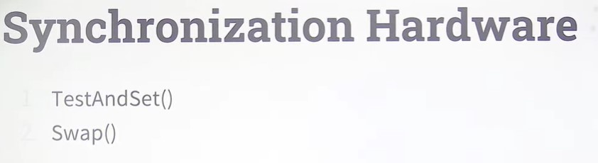

Slide 21
Synchronization Hardware
Many systems provide hardware support for implementing the critical section code.
Uniprocessors – could disable interrupts
Currently running code would execute without preemption
Generally too inefficient on multiprocessor systems
Operating systems using this not broadly scalable
We will look at three forms of hardware support: 1. Hardware instructions 2. Atomic variables

Slide 22
Hardware Instructions
Special hardware instructions that allow us to either test-and-modify the content of a word, or to swap the contents of two words atomically (uninterruptedly.)
Test-and-Set instruction
Compare-and-Swap instruction

Slide 23
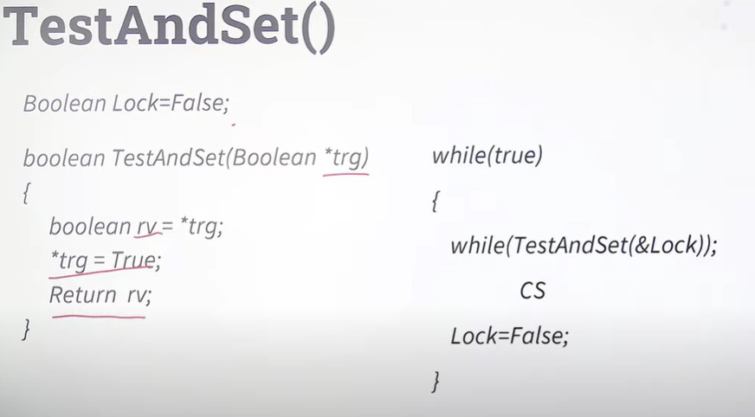
TestAndSet()

Slide 24
The test_and_set Instruction
Definition
boolean test_and_set (boolean *target)
{
boolean rv = *target;
*target = true;
return rv:
}
Properties
Executed atomically
Returns the original value of passed parameter
Set the new value of passed parameter to true

Slide 25
Solution Using test_and_set()
Shared boolean variable lock, initialized to false
Solution:
do { while (test_and_set(&lock))
; /* do nothing */
/* critical section */
lock = false;
/* remainder section */
} while (true);
Does it solve the critical-section problem?

Slide 26
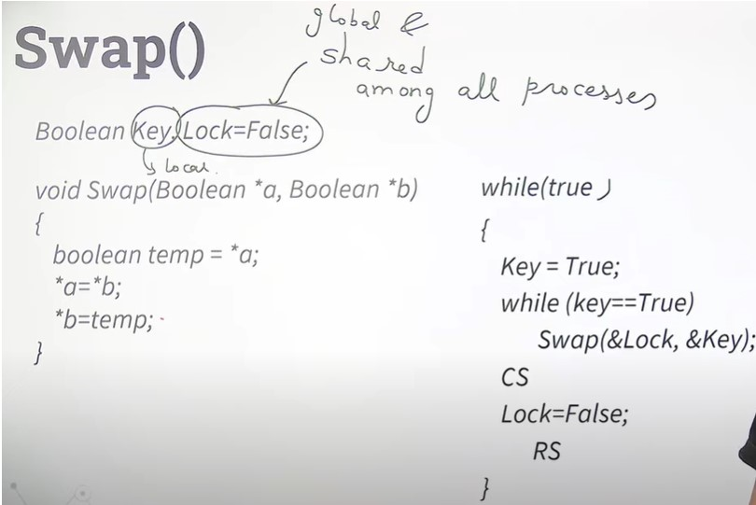
Swap()

Slide 27
The compare_and_swap Instruction
Definition
int compare_and_swap(int *value, int expected, int new_value)
{
int temp = *value;
if (*value == expected)
*value = new_value;
return temp;
}
Properties
Executed atomically
Returns the original value of passed parameter value
Set the variable value the value of the passed parameter new_value but only if *value == expected is true. That is, the swap takes place only under this condition.

Slide 28
Solution using compare_and_swap
Shared integer lock initialized to 0;
Solution:
while (true){ while (compare_and_swap(&lock, 0, 1) != 0)
; /* do nothing */
/* critical section */
lock = 0;
/* remainder section */
}
Does it solve the critical-section problem?

Slide 29
Atomic Variables
Typically, instructions such as compare-and-swap are used as building blocks for other synchronization tools.
One tool is an atomic variable that provides atomic (uninterruptible) updates on basic data types such as integers and booleans.
For example:
Let sequence be an atomic variable
Let increment() be operation on the atomic variable sequence
The Command:
increment(&sequence);
ensures sequence is incremented without interruption:

Slide 30
Atomic Variables
The increment() function can be implemented as follows: void increment(atomic_int *v) { int temp; do { temp = *v; } while (temp != (compare_and_swap(v,temp,temp+1)); }

Slide 31
Mutex Locks
Previous solutions are complicated and generally inaccessible to application programmers
OS designers build software tools to solve critical section problem
Simplest is mutex lock
Boolean variable indicating if lock is available or not
Protect a critical section by
First acquire() a lock
Then release() the lock
Calls to acquire() and release() must be atomic
Usually implemented via hardware atomic instructions such as compare-and-swap.
But this solution requires busy waiting
This lock therefore called a spinlock

Slide 32
Solution to CS Problem Using Mutex Locks
while (true) {
acquire lock
critical section
release lock
remainder section
}

Slide 33

Synchronization Tools

Slide 34
Semaphore
Synchronization tool that provides more sophisticated ways (than Mutex locks) for processes to synchronize their activities.
Semaphore S – integer variable
Can only be accessed via two indivisible (atomic) operations
wait() and signal()
Originally called P() and V()
Definition of the wait() operation
wait(S) {
while (S <= 0)
; // busy wait
S--;
}
Definition of the signal() operation
signal(S) {
S++;
}

Slide 35
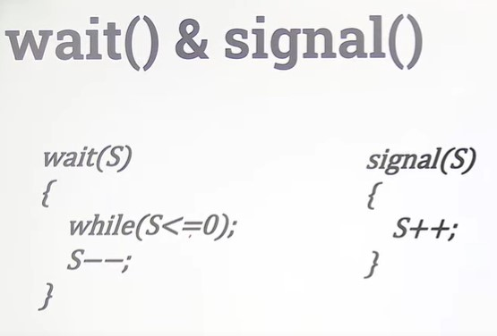
Semaphore

Slide 36
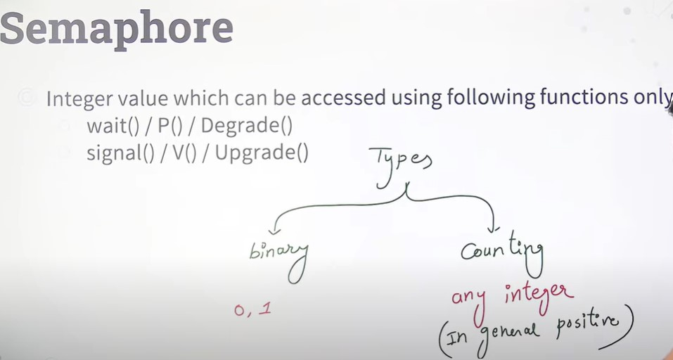
Types of Semaphore

Slide 37
Semaphore (Cont.)
Counting semaphore – integer value can range over an unrestricted domain
Binary semaphore – integer value can range only between 0 and 1
Same as a mutex lock
Can implement a counting semaphore S as a binary semaphore
With semaphores we can solve various synchronization problems

Slide 38
Semaphore Usage Example
Solution to the CS Problem
Create a semaphore “mutex” initialized to 1
wait(mutex);
CS
signal(mutex);
Consider P₁ and P₂ that with two statements S₁ and S₂ and the requirement that S₁ to happen before S₂
Create a semaphore “synch” initialized to 0
P1:
S₁;
signal(synch);
P2:
wait(synch);
S₂;

Slide 39
Semaphore Implementation
Must guarantee that no two processes can execute the wait() and signal() on the same semaphore at the same time
Thus, the implementation becomes the critical section problem where the wait and signal code are placed in the critical section
Could now have busy waiting in critical section implementation
But implementation code is short
Little busy waiting if critical section rarely occupied
Note that applications may spend lots of time in critical sections and therefore this is not a good solution

Slide 40
Semaphore Implementation with no Busy waiting
With each semaphore there is an associated waiting queue
Each entry in a waiting queue has two data items:
Value (of type integer)
Pointer to next record in the list
Two operations:
block – place the process invoking the operation on the appropriate waiting queue
wakeup – remove one of processes in the waiting queue and place it in the ready queue

Slide 41
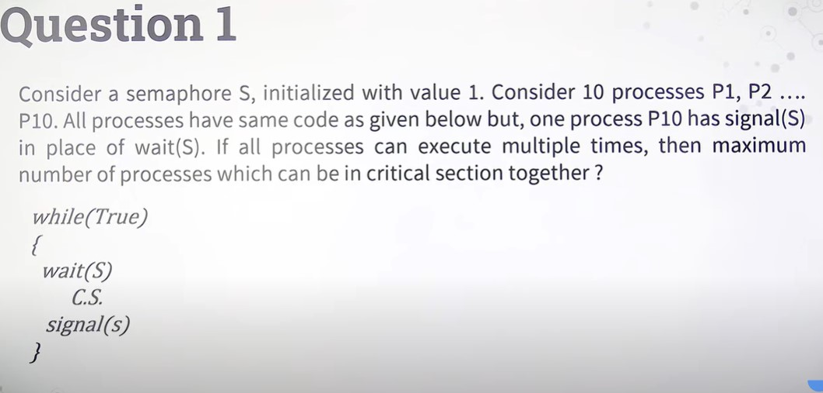

Slide 42
Problems with Semaphores
Incorrect use of semaphore operations:
signal(mutex) …. wait(mutex)
wait(mutex) … wait(mutex)
Omitting of wait (mutex) and/or signal (mutex)
These – and others – are examples of what can occur when semaphores and other synchronization tools are used incorrectly.

Slide 43
Monitors
A high-level abstraction that provides a convenient and effective mechanism for process synchronization
Abstract data type, internal variables only accessible by code within the procedure
Only one process may be active within the monitor at a time
Pseudocode syntax of a monitor:
monitor monitor-name
{
// shared variable declarations
procedure P1 (…) { …. }
procedure P2 (…) { …. }
procedure Pn (…) {……}
initialization code (…) { … }
}

Slide 44
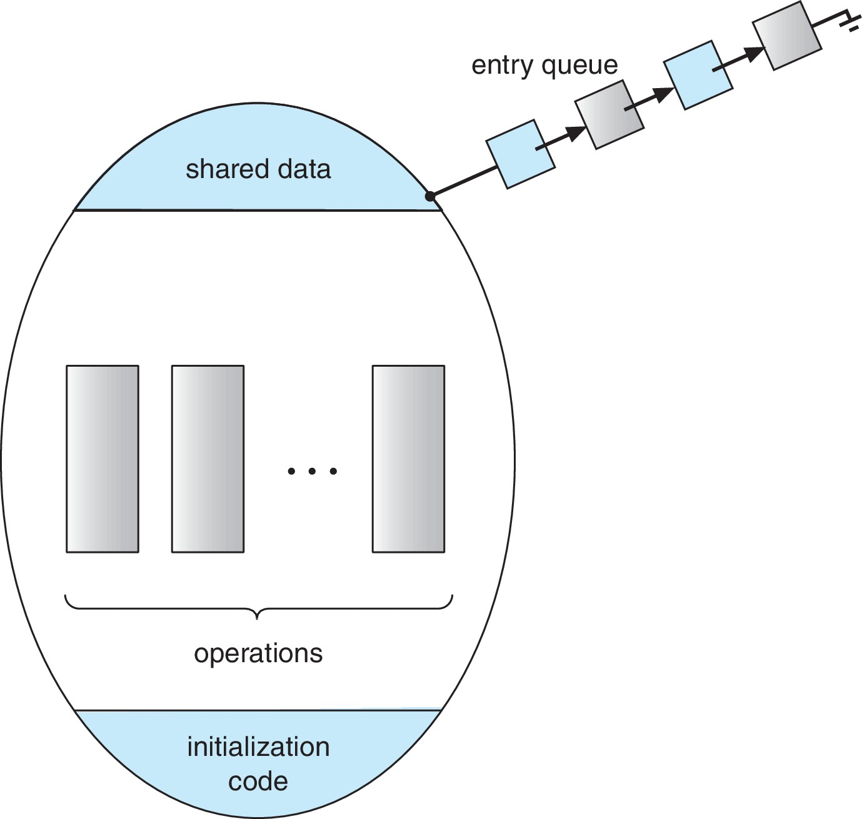
Schematic view of a Monitor

Slide 45
Monitor Implementation Using Semaphores
Variables
semaphore mutex
mutex = 1
Each procedure P is replaced by
wait(mutex);
…
body of P;
…
signal(mutex);
Mutual exclusion within a monitor is ensured

Slide 46
End of Chapter 6

